Slide 1
DSA-II Miniproject: A dictionary application
Name: Anushka Tadphale
MIS: 111903019
Div- 1

Slide 2
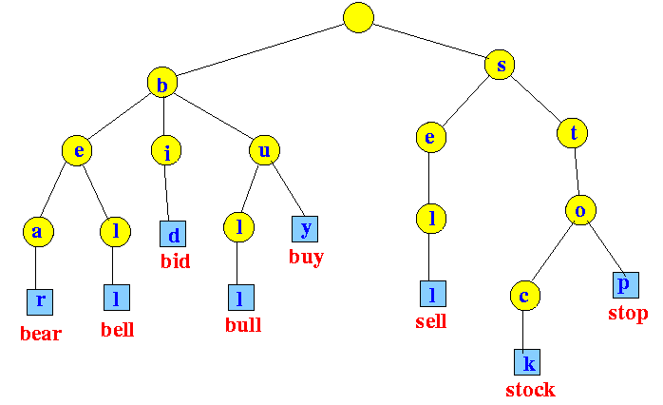
Data structure used: Trie (Trie/ Prefix tree/ digital tree)
Why trie?
Dictionary can be implemented using other structure like Hash tables or ternary search tree, but trie is preferable due to following reasons
Free from collision
Searching is faster, and prefix searching becomes easy
Words by default stored in alphabetical order
No hash function required, like in case of hash tables
Disadvantage: requires more space

Slide 3
Functionalities implemented
Insertion of new word in trie
Load from text file data(words and meaning )
Searching for meaning of word in existing data set(dictionary)
If word not found, words with its common prefix i.e similar words are shown
Can add new words to dictionary
Delete and existing word
Keeping record of search history and displaying history
GUI based implementation using windows.h library

Slide 4
Insertion
Go character by character
Index calculated as: ch - ‘a’ [lower case taken into consideration, uppercases converted to lower case]
For each character, create a new node in array if there is no node present at that index
Traverse to next index
Time complexity: O(n) , n= length of word
Insert function called for each word in load_dict() function which will load every word and its meaning from the text file into trie

Slide 5
Searching a word
Search a word and print its meaning
If exact match of word not found, then similar words are printed
For similar searching: find the prefix in that word upto which it exists in our dictionary.
Will print all words having that common prefix
Time complexity: O(n), n= length of word

